Slide 1

STRUCTURED QUERY LANGUAGE
SQL
Inventory Management System
UNDER THE GUIDENCE OF: PROF. JAFFRIN
BESANT TECHNOLOGIES
PRESENTED BY: ASHOKKUMAR M

Slide 2
SQL
What is SQL
Uses of SQL
Why SQL is used
SQL (Structured Query Language) is a programming language designed for managing and interacting with relational databases. It allows users to query, manipulate, and control data in a structured and standardized manner.
Data Querying
Data Modification
Data Definition
Data Control
Data Integrity
Data Transactions
Data Aggregation and Reporting
Stored Procedures and Functions
SQL is used to manage and interact with relational databases, enabling tasks such as data retrieval, modification, definition, access control, data integrity maintenance, transaction management, and report generation. It is a fundamental language in database management and is widely used in software development and data analysis.

Slide 3
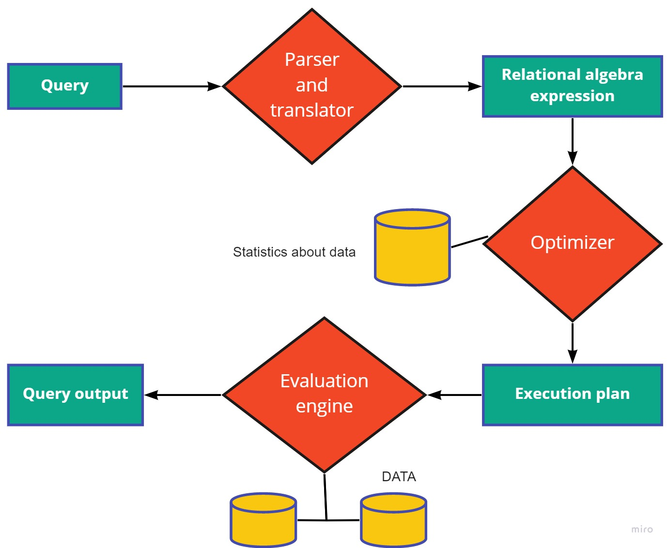
What is Query:
A query in databases, particularly in SQL, is a concise command for interacting with data. It's a specific request to retrieve, modify, or manage information stored in a database. Queries are crucial for tasks like data analysis, reporting, and maintaining database integrity.

Slide 4

Why is SQL crucial for websites?
SQL is crucial for websites because it enables efficient data management. SQL databases, like MySQL or PostgreSQL, store and retrieve data, allowing websites to dynamically generate content, manage user authentication, process e-commerce transactions, and ensure data integrity. SQL supports scalable solutions, essential for growing websites, and facilitates powerful search functionality, analytics, and reporting. It serves as a robust foundation for various web applications, contributing to their functionality, security, and effective handling of user interactions and data.

Slide 5

Inventory Management System

Slide 6
Introduction to Inventory Management System
Welcome to the Inventory Management System, a comprehensive database designed to streamline and manage product-related data efficiently. This system facilitates the organization and monitoring of products, their associated details, and the employees responsible for handling them. By leveraging the power of SQL, the Inventory Management System ensures seamless tracking, reporting, and analysis of inventory-related activities, contributing to enhanced operational efficiency.
The Inventory Management System is a sophisticated SQL-based solution designed to efficiently manage and monitor product-related information. This system empowers organizations to track products, their deliveries, and associated employee details seamlessly. Explore insightful queries for real-time reporting and analysis, ensuring optimal control over your Inventory Management.

Slide 7
Employers Table
s_no INT auto_increment primary key
e_name varchar(40)
designation varchar(40)
location varchar(40)
Gender enum('Male','Female’)
emp_id int unique
ph_no int unique
salary int
department varchar(50)
join_date Date
Products Table
pro_id INT
pro_name VARCHAR(40)
emp_id INT
FOREIGN KEY (emp_id) REFERENCES Employ(emp_id)
Delivery_loc VARCHAR(40)
delivery_date DATE

Slide 8
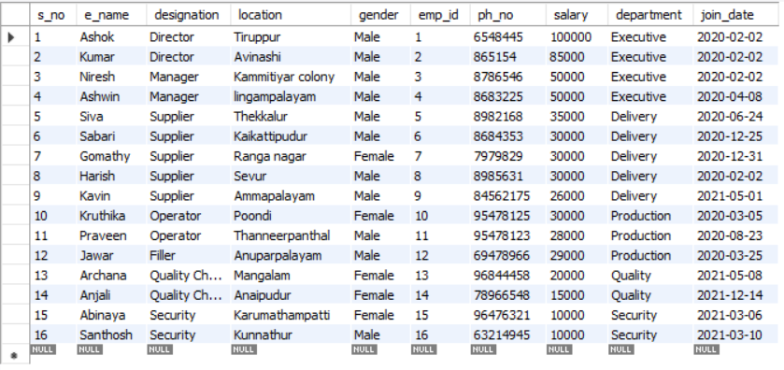
Employers Table

Slide 9
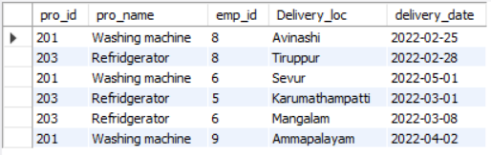
Products Table

Slide 10
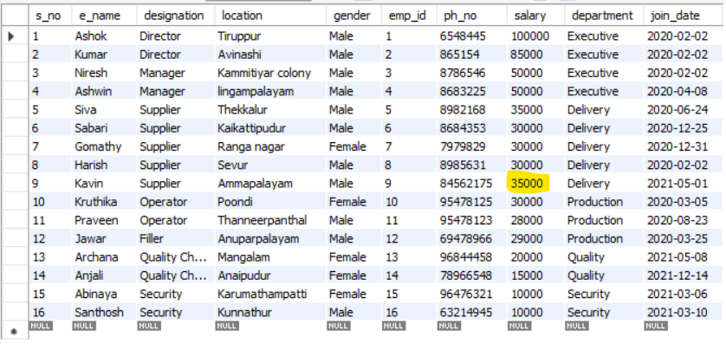
1. Query to Update value in the Table
UPDATE Employ SET salary = 35000 WHERE emp_id = 009;

Slide 11

2.Query to view the employees who are receiving a salary greater than 50000
SELECT * FROM Employ WHERE salary > 50000;

Slide 12


3.Query to view the sum and Average of the salary as the total salary and avg salary
SELECT SUM(salary) AS total_salary FROM Employ; SELECT AVG(salary) AS avg_salary FROM Employ;

Slide 13
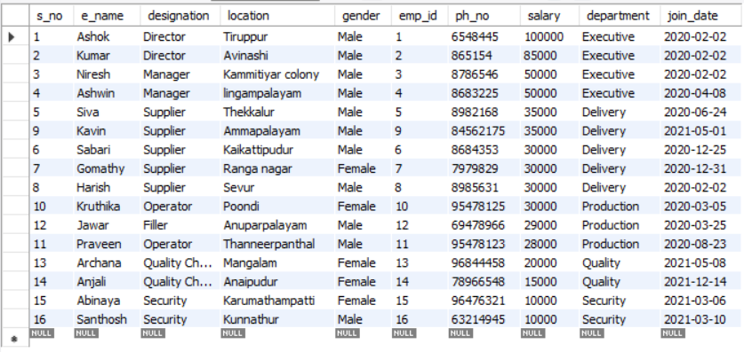
4.Query Using the function Order by :
SELECT * FROM Employ ORDER BY salary DESC;

Slide 14
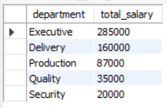
5.Query Using the Function Group by:
SELECT department, SUM(salary) AS total_salary FROM Employ GROUP BY department;

Slide 15
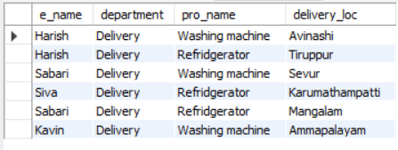
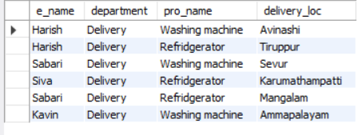
6.Query using the Function Join:
INNER JOIN:
SELECT e.e_name, e.department, p.pro_name, p.delivery_loc FROM Employ e INNER JOIN Products p ON e.emp_id = p.emp_id;
Right Join:
SELECT e.e_name, e.department, p.pro_name, p.delivery_loc FROM Employ e RIGHT JOIN Products p ON e.emp_id = p.emp_id;

Slide 16
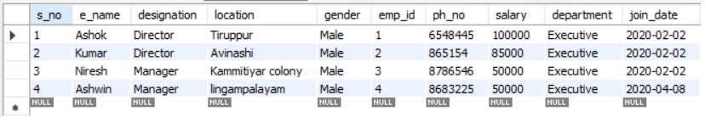
7.Using Sub-Query:
SELECT * FROM employ WHERE salary > (SELECT AVG(salary) FROM employ);

Slide 17


8.Query to find Minimum and Maximum Salary:
SELECT min(salary) as 'minimum salary' from employ; Select max(salary) as 'maximum salary' from employ;

Slide 18

9.Query to Count the Values in a particular Column:
select count(emp_id) from products;

Slide 19
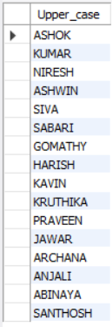
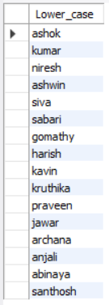
10.Query To View The String Values In Upper And Lower Case:
select ucase(e_name) as Upper_case from employ;
select Lcase(e_name) as Lower_case from employ;

Slide 20
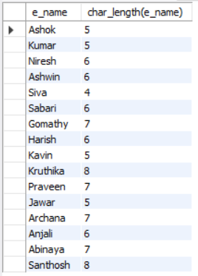
11. Query to find the Character Length:
select e_name, char_length(e_name) from employ;

Slide 21
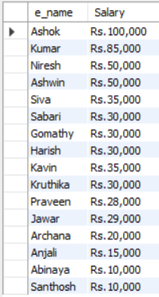
12. Concat and Format:
select e_name, concat('Rs.',format(salary,0)) as Salary from employ;

Slide 22
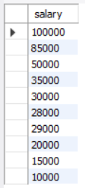
13. Query using the Function Having:
select salary from employ group by salary having max(salary) >= 10000;

Slide 23
Conclusion:
The Inventory Management System, driven by SQL, revolutionizes product and employee management.
Our database structure ensures seamless data organization and retrieval.
SQL queries empower real-time insights, reporting, and informed decision-making.
Benefits include heightened operational efficiency and a data-driven approach to inventory management.
As we advance, we anticipate continuous improvement and scalability.
Thank you for exploring the Inventory Management System.

Slide 24


